Slide 1


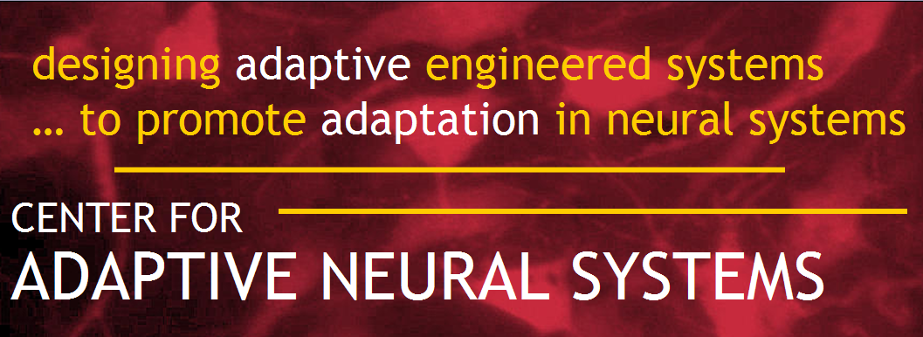
Analysis of the Effects of Treadmill Therapy Training on Sensorimotor Function in Spinal Cord Injured Rats
Jared Bartell, Mallika Fairchild, PhD, Ranu Jung, PhD
Contact: jbartell@asu.edu
Ira A. Fulton Schools of Engineering
Center for Adaptive Neural Systems
Arizona State University
Tempe, AZ

Slide 2
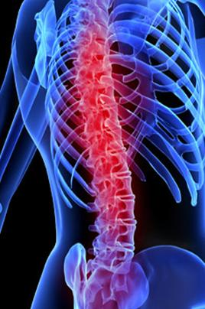
Spinal Cord Injury Background
250,000 people in the United States currently living with spinal cord injury (SCI)¹
52% paraplegia
47% quadraplegia
Estimated $9.7 billion each year
SCI population increasing
¹Spinal Cord Injury Facts & Statistics, 2009
http://www.sciam.com/article.cfm?id=nervous-system-restores-movement
Notes:
Incidence: 20,000 new cases per year.
Prevalence: 40 cases per million.
Picture taken withough permission from http://www.sciam.com/article.cfm?id=nervous-system-restores-movement

Slide 3
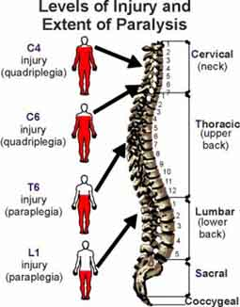
Spinal Cord Injury Background
Complete SCI:
  Paralysis below lesion
  Disappearance of all motor and sensory control
Incomplete SCI (iSCI):
  Varying degrees of injury
  Some sparing of supraspinal motor control and/or sensory functionality
http://www.arkansas-ican.org/Spinal%20Cord%20Injury.htm
Notes:
Picture taken without permission from http://www.arkansas-ican.org/Spinal%20Cord%20Injury.htm

Slide 4
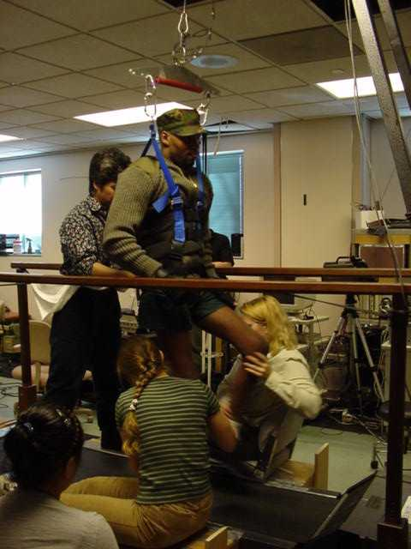
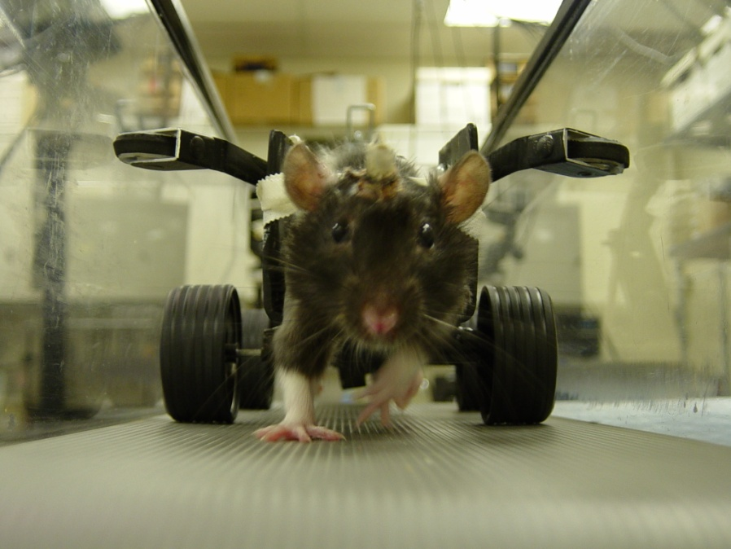
Rationale
SCI treatment approaches available:
  pharmacological intervention
  stem cell impregnation
  electrostimulation
  REHABILITATION THERAPY
Similar physiological mechanisms involved in SCI support validity of rat model.
http://www.harkema.ucla.edu/bws.html
Center for Adaptive Neural systems, ASU
Notes:
Top Picture taken withought permissionfrom http://www.harkema.ucla.edu/bws.html
Bottom Picture taken with permission from CANS, ASU

Slide 5
Hypothesis
Greater recovery to locomotion will be induced in iSCI rats receiving active treadmill training therapy compared to rats that do not receive therapy.

Slide 6
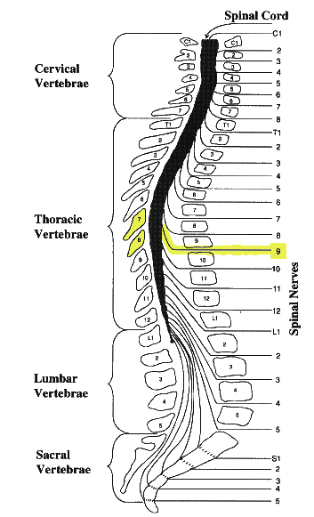
Methods
 | Treadmill Training |  | |← Treadmill Training →|
 | PRE-INJURY |  | 2 WPI | 3 WPI | 4 WPI | 5 WPI | 6 WPI
Moderate-severe contusion induced on T9 Spinal cord level (thoracic vertebrae 8).
Four CCD cameras recorded animals’ performance. Peak Motus Motion Analysis System used to capture, digitize and process video.
http://images.main.uab.edu/spinalcord/
graphicimages/bspine.gif
Notes:
Four cameras recorded animal’s performance. Video later collected, digitized and processed.
Animals euthanized and dissected to examine the spinal cord and brain tissues using histological staining techniques.

Slide 7
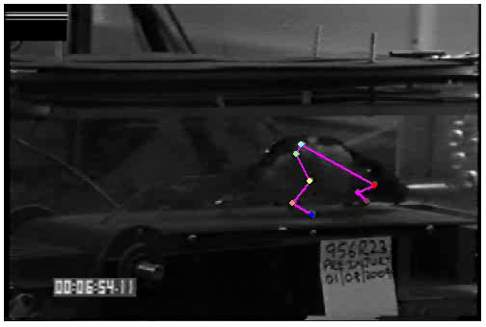
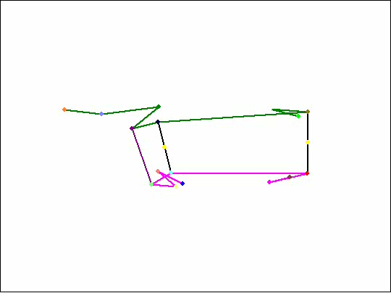
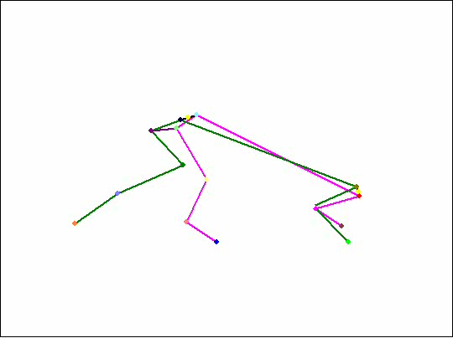
3d kinematics treadmill testing
Pre-Injury
Pre-Injury data collected for all animals

Slide 8
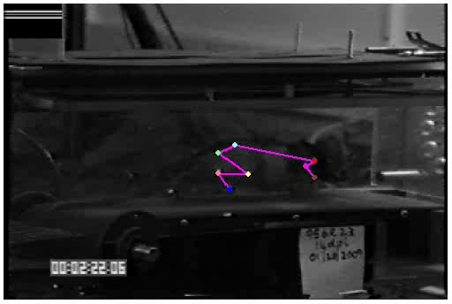
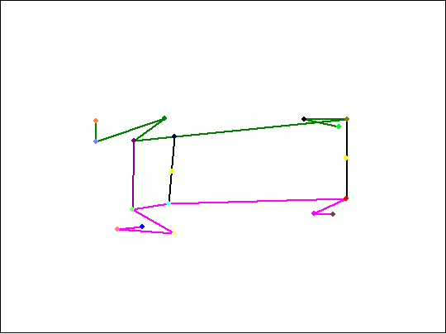
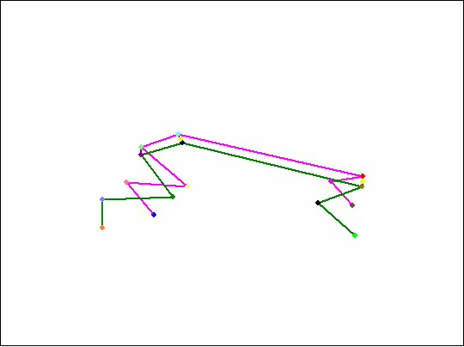
3d kinematics treadmill testing
2 Weeks Post-Injury
At 2wpi: 1/4 NT rats + 2/8 TT rats walked successfully

Slide 9
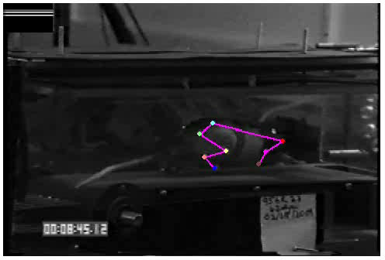
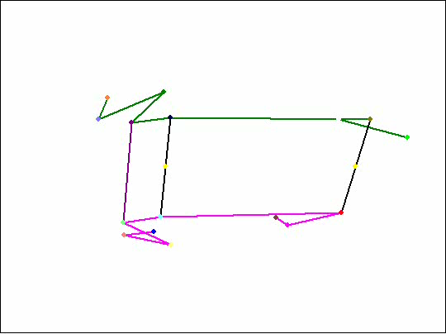
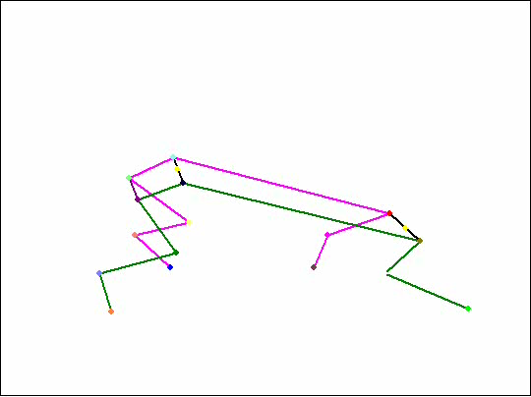
3d kinematics treadmill testing
6 Weeks Post-Injury
At 6wpi: 2/4 NT rats + 8/8 TT rats walked successfully

Slide 10
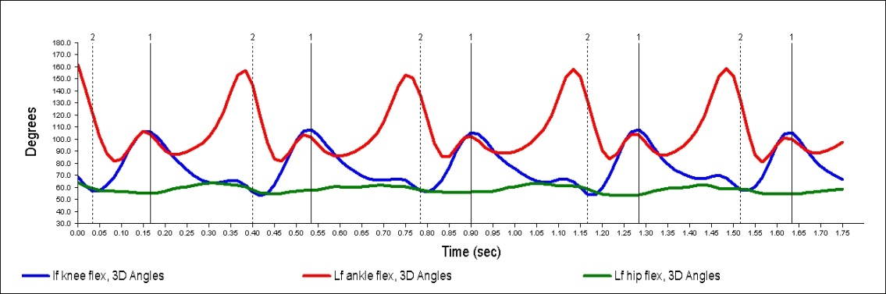
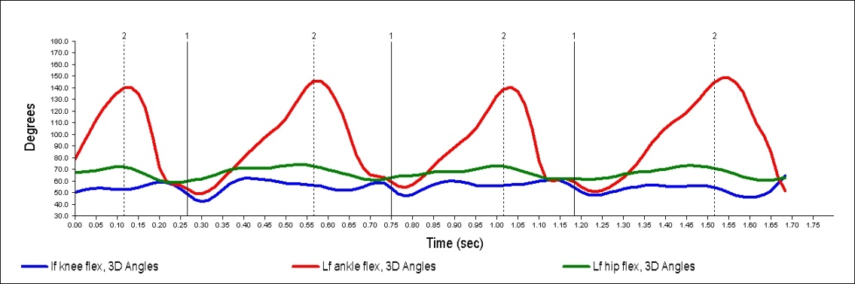
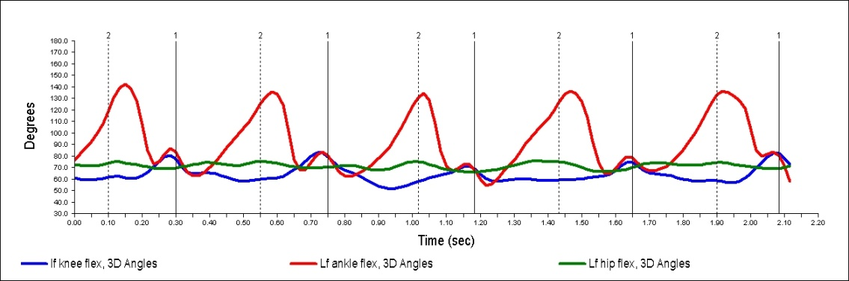
Interlimb coordination
Pre-Injury
2 WPI
6 WPI
Notes:
At Pre-Injury, ankle flexion angles follow a quintic, 90 degrees out-of-phase relationship with the knee flexion angles.
At 2wpi, ankle flexion angles have been reduced to follow a cubic trend; knee flexion angles significantly altered.
At 6wpi, quintic ankle flexion angle trend mostly returned but offset so not quite 90 degrees out-of-phase with the improved knee flexion angles.
Hip flexion angles shown as a rough baseline (little or no movement seen through across joint throughout gait cycle)

Slide 11
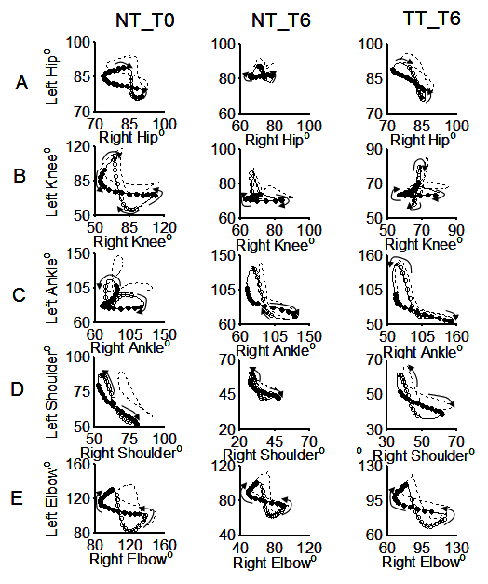
Interlimb coordination
Figure 8 pattern
Cruciform variation
Overextension
By 6wpi, greater improvement in interlimb coordination for all joint angles in TT group, compared to NT group.

Slide 12
Interlimb coordination
Swing and Stance Phase Durations and Footfall Pattern Over Time (4 cycles)
TT Pre 1:1
Normal gait pattern
Stance/swing durations remain altered by 6wpi, however TT group with 2FL:1HL compensatory coordination shows greater improvement
NT 6wpi1:1
TT 6wpi 1:1
TT 6wpi 2:1
STANCE
SWING
Hindlimb (HL) and forelimb (FL) L: Left and R: Right.

Slide 13
Summary of Results
8/8 of the TT animals, as opposed to only 2/4 of the NT animals were able to successfully walk on the treadmill at 6 wpi.
Joint angles and footfall patterns showed altered stance and swing durations for the 6wpi animals, however the TT group showed greater improvement.
Intralimb coordination differences between NT and TT at 6wpi not significant.

Slide 14
Future Research
Use combinatorial therapies such as neuromuscular electrical stimulation along with treadmill therapy to improve recovery of sensorimotor function by targeting specific structural plasticity.
Compare / combine additional therapies for SCI.
Better understand recovery mechanisms.

Slide 15


Acknowledgments
Mallika Fairchild
Center for Adaptive Neural Systems, Harrington Bioengineering, ASU
Brian Hillen
Center for Adaptive Neural Systems, Harrington Bioengineering, ASU
Alex Iarkov, PhD
Center for Adaptive Neural Systems, ASU
Ronald Hammer, PhD
Department of Psychology, ASU; U of A College of Medicine – Phoenix
Ranu Jung, PhD
Center for Adaptive Neural Systems, Harrington Bioengineering, ASU
Supported by SFAZ CAA0282‐08.
Thank you!
http://ans.asu.edu

